Slide 1
Naming
Outline
  Terminology
  Domain Naming System
  Distributed File Systems

Slide 2
Overview
What do names do?
  identify objects
  help locate objects
  define membership in a group
  specify a role
  convey knowledge of a secret
Name space
  defines set of possible names
  consists of a set of name to value bindings

Slide 3
Properties
Names versus addresses
Location transparent versus location-dependent
Flat versus hierarchical
Global versus local
Absolute versus relative
By architecture versus by convention
Unique versus ambiguous

Slide 4
Examples
Hosts
  cheltenham.cs.princeton.edu 192.12.69.17
  192.12.69.17 80:23:A8:33:5B:9F
Files
  /usr/llp/tmp/foo (server, fileid)
Users
  Larry Peterson llp@cs.princeton.edu

Slide 5
Examples (cont)
Mailboxes
Services
    nearby ps printer with short queue and 2MB
2
User
1
cs.princeton.edu
user @ cs.princeton.edu
Name
Mail
server
program
192.12.69.5
192.12.69.5
4
3
TCP
192.12.69.5
5
IP

Slide 6
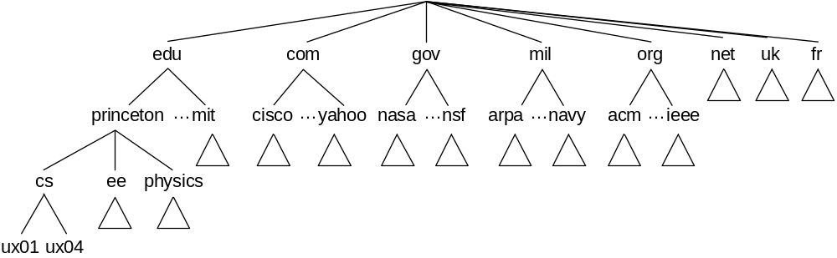
Domain Naming System
Hierarchy
Name
    chinstrap.cs.princeton.edu

Slide 7
Name Servers
Partition hierarchy into zones
edu
com
gov
mil
org
net
uk
fr
princeton
…
mit
cisco
…
yahoo
nasa
…
nsf
arpa
…
navy
acm
…
ieee
cs
ee
physics
ux01
ux04
Root
Each zone implemented by two or more name servers
name server
Princeton
…
Cisco
name server
name server
CS
…
EE
name server
name server

Slide 8
Resource Records
Each name server maintains a collection of resource records
    (Name, Value, Type, Class, TTL)
Name/Value: not necessarily host names to IP addresses
Type
  NS: Value gives domain name for host running name server that knows how to resolve names within specified domain.
  CNAME: Value gives canonical name for particle host; used to define aliases.
  MX: Value gives domain name for host running mail server that accepts messages for specified domain.
Class: allow other entities to define types
TTL: how long the resource record is valid

Slide 9
Root Server
(princeton.edu, cit.princeton.edu, NS, IN)
(cit.princeton.edu, 128.196.128.233, A, IN)
(cisco.com, thumper.cisco.com, NS, IN)
(thumper.ciscoe.com, 128.96.32.20, A, IN)
…

Slide 10
Princeton Server
(cs.princeton.edu, optima.cs.princeton.edu, NS, IN)
(optima.cs.princeton.edu, 192.12.69.5, A, IN)
(ee.princeton.edu, helios.ee.princeton.edu, NS, IN)
(helios.ee.princeton.edu, 128.196.28.166, A, IN)
(jupiter.physics.princeton.edu, 128.196.4.1, A, IN)
(saturn.physics.princeton.edu, 128.196.4.2, A, IN)
(mars.physics.princeton.edu, 128.196.4.3, A, IN)
(venus.physics.princeton.edu, 128.196.4.4, A, IN)

Slide 11
CS Server
(cs.princeton.edu, optima.cs.princeton.edu, MX, IN)
(cheltenham.cs.princeton.edu, 192.12.69.60, A, IN)
(che.cs.princeton.edu, cheltenham.cs.princeton.edu, CNAME, IN)
(optima.cs.princeton.edu, 192.12.69.5, A, IN)
(opt.cs.princeton.edu, optima.cs.princeton.edu, CNAME, IN)
(baskerville.cs.princeton.edu, 192.12.69.35, A, IN)
(bas.cs.princeton.edu, baskerville.cs.princeton.edu, CNAME, IN)

Slide 12
Name Resolution
Strategies
  forward
  iterative
  recursive
Local server
  need to know root at only one place (not each host)
  site-wide cache
2
Root
name
server
cicada.cs.princeton.edu
3
princeton.edu, 128.196.128.233
1
4
cicada.cs.princeton.edu
Local
cicada.cs.princeton.edu
Princeton
Client
name
name
192.12.69.60
server
cs.princeton.edu, 192.12.69.5
server
8
5
cicada.cs.princeton.edu
192.12.69.60
cicada.cs.princeton.edu,
6
CS
name
7
server

Slide 13
Distributed File Systems
No Transparency
  Global AFS: /cs.princeton.edu/usr/llp/tmp/foo
  Windows: f:/usr/llp/tmp/foo
Transparency by Convention
  NFS: /usr/llp/tmp/foo
  Or Not: /n/fs/fac5/llp/tmp/foo
Transparency by Architecture
  Sprite: /usr/llp/tmp/foo
Private versus Shared
  ASF: /usr/llp/tmp/foo versus /afs/shared

Slide 14
Stupid Naming Tricks
Symbolic links
Mount points
Union mounts
Per-User name spaces
Logical name spaces
Computed directories

